Slide 1
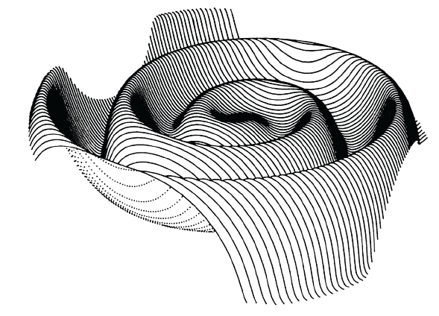

Understanding the in-situ Solar Wind Properties with Machine Learning and Artificial Intelligence
Arturo Avila-Lares
Brandyn Mahan
Andrea Newlands
Notes:
Hi all! Our capstone project aims to understand in situ solar wind properties using machine learning and ai. Solar wind is a flow of particles made of mostly protons and electrons that are thrown from the sun’s atmosphere, which is too hot for the sun’s gravity to contain. Solar wind is influenced by the Sun’s 11 year solar cycle, over which the Sun’s magnetic poles flip. The beginning of the cycle, called the solar minimum, is when the Sun produces fewer sunspots and less intense solar wind. At the middle of the cycle is the solar maximum, where the Sun produces more sunspots and intenser solar wind. Understanding solar wind and predicting its intensity is important because it can have immense impacts on things like satellite operations, power grids, and telecommunication systems and can also pose a threat to astronauts traveling in space.
The first part of our project focuses on data from the Advanced Composition Explorer , or ACE, mission, a satellite launched by NASA in 1997 that collects data on solar wind. The ACE Mission dataset is a collection of particle measurements from solar, interplanetary, and interstellar origins. Our project focused on the solar wind measurements collected by the ACE satellite with the goal of finding additional features for use in the second part of our project. After cleaning the dataset of missing values, the features used were proton density, proton temperature, Helium-4 to proton ratio, and proton speed. K-means was utilized for feature importance and DBSCAN for solar wind classification.
Feature importance was inconclusive with K-means when using the ACE features as given. Clusters did not have distinct decision boundaries and were tightly packed. When prepping the dataset with PCA to create two principal components, K-means was able to create distinct clusters, though they were still right next to each other. DBSCAN clustered 99% of all data points in a single cluster resulting in no distinct classification pattern for solar wind types.
The second part of our project focuses on the heliospheric current sheet indexes. The heliospheric current sheet, or HCS, is a plane at the sun’s equator that serves as the boundary between the Sun’s magnetic dipoles. As the sun’s solar cycle progresses, the HCS fluctuates in how wavy and tilted it is. The indexes, which measure both the standard deviation of the HCS’s latitude, the SD, and the HCS’s integrated slope, the SL, can help measure the HCS’s complexity and track the solar cycle.
While we had hoped to incorporate the principal components produced by the clustering of the ACE data into the forecast of the HCS indexes, joining the datasets resulted in a great reduction in the amount of data available to train on and created poor-performing models. Instead, only the monthly average sunspot number and lag columns were used as predictors. We compared different cross-validated models using R^2 and multiple error metrics and determined Ridge Regression was the best model for forecasting the HCS indexes. After hypertuning the Ridge Regression models, the model for SD returned an R^2 for 0.78 while the model of SL returned a R^2 of 0.59.
Here you can see side-by-side line charts displaying actual data, predictions on the test set, and forecasts for the next 24 months post-May 2022. The model seems to do well on the data used in the test set, however future data should be used to further evaluate the model’s accuracy
We hope this project lays the groundwork for more precise predictive models in future studies. Our hope is that more HCS index data can be collected to refine the models further and that additional features such as solar wind be incorporated into the models.
Finally, a huge thank you to Dr. Zhao from the University of Michigan and Kyle Balog from the Capstone Course staff. This project was completed under their stellar advice and they were an immense help. Thanks!

Slide 2
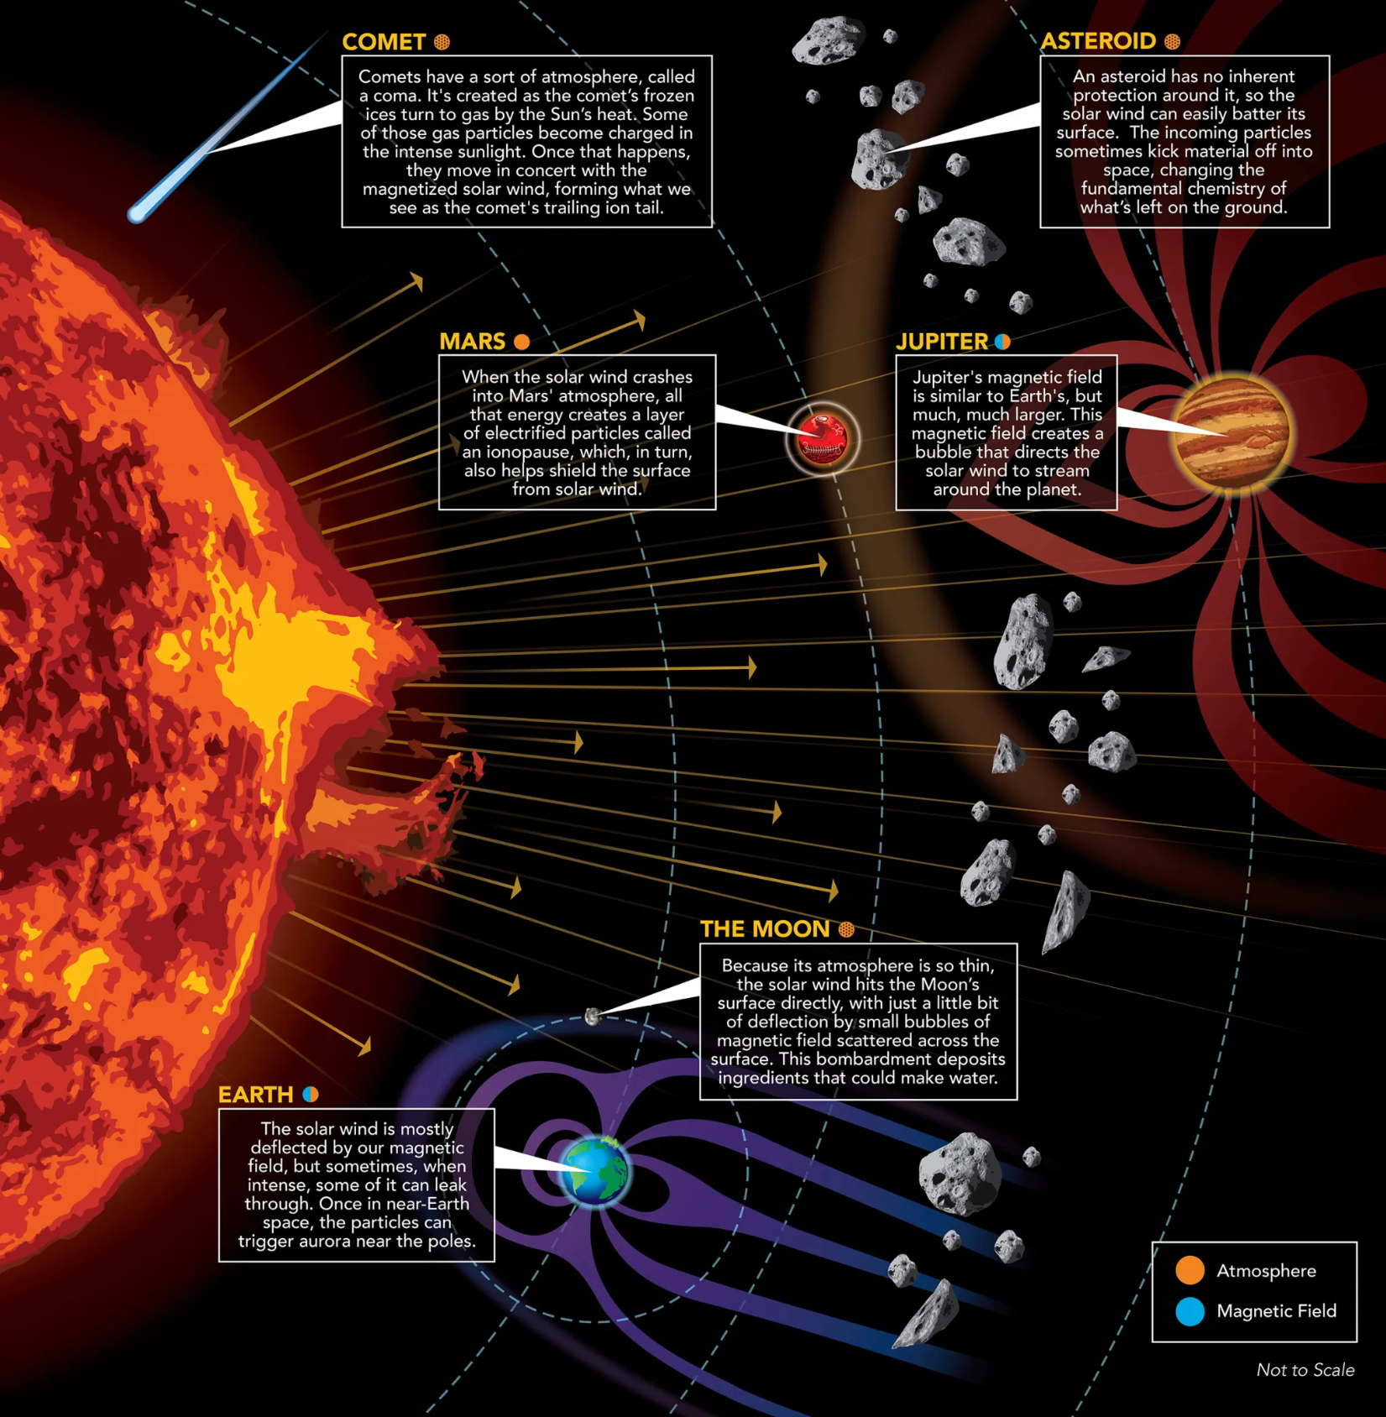
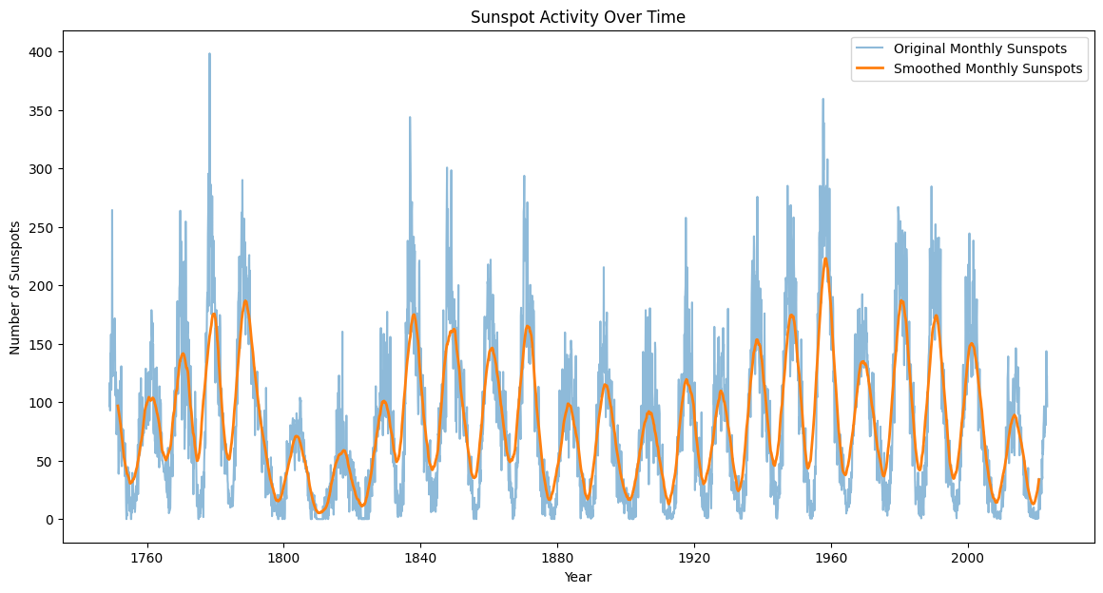
What is
Solar Wind?
(NASA’s Goddard Space Flight Center, Mary Pat Hrybyk-Keith)
Notes:
Our capstone project aims to understand in situ solar wind properties using machine learning and ai. Solar wind is a flow of particles made of mostly protons and electrons that are thrown from the sun’s atmosphere, which is too hot for the sun’s gravity to contain. Solar wind is influenced by the Sun’s 11 year solar cycle, when the Sun’s magnetic poles flip. The beginning of the cycle, called the solar minimum, is when the Sun produces fewer sunspots and less intense solar wind. At the middle of the cycle is the solar maximum, where the Sun produces more sunspots and intenser solar wind. Understanding solar wind and predicting its intensity is important because it can have immense impacts on things like satellite operations, power grids, and telecommunication systems and can also pose a threat to astronauts traveling in space.
https://science.nasa.gov/resource/the-solar-wind-across-our-solar-system/

Slide 3
ACE Mission
Measurements of Solar Wind Properties
Structure:
Organized in hourly averages from 1998 to 2022.
Features:
Proton_density
Proton_temp
He4toprotons
Proton_speed
Clustering:
K-means for feature importance
DBSCAN for solar wind classification
Notes:
The first part of our project focuses on data from the ACE mission, a satellite launched by NASA in 1997 that collects data on solar wind. The ACE Mission dataset is a collection of particle measurements from solar, interplanetary, and interstellar origins. Our project focused on the solar wind measurements collected by the ACE satellite with the goal of finding additional features for the forecast model and determining types of solar wind that could be linked to the HCS forecast. After cleaning the dataset of missing values the features used were proton density, proton temperature, He4toprotons, and proton speed. K-means was utilized for feature importance and DBSCAN for solar wind classification.

Slide 4
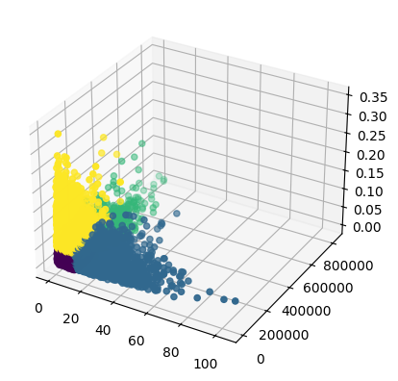
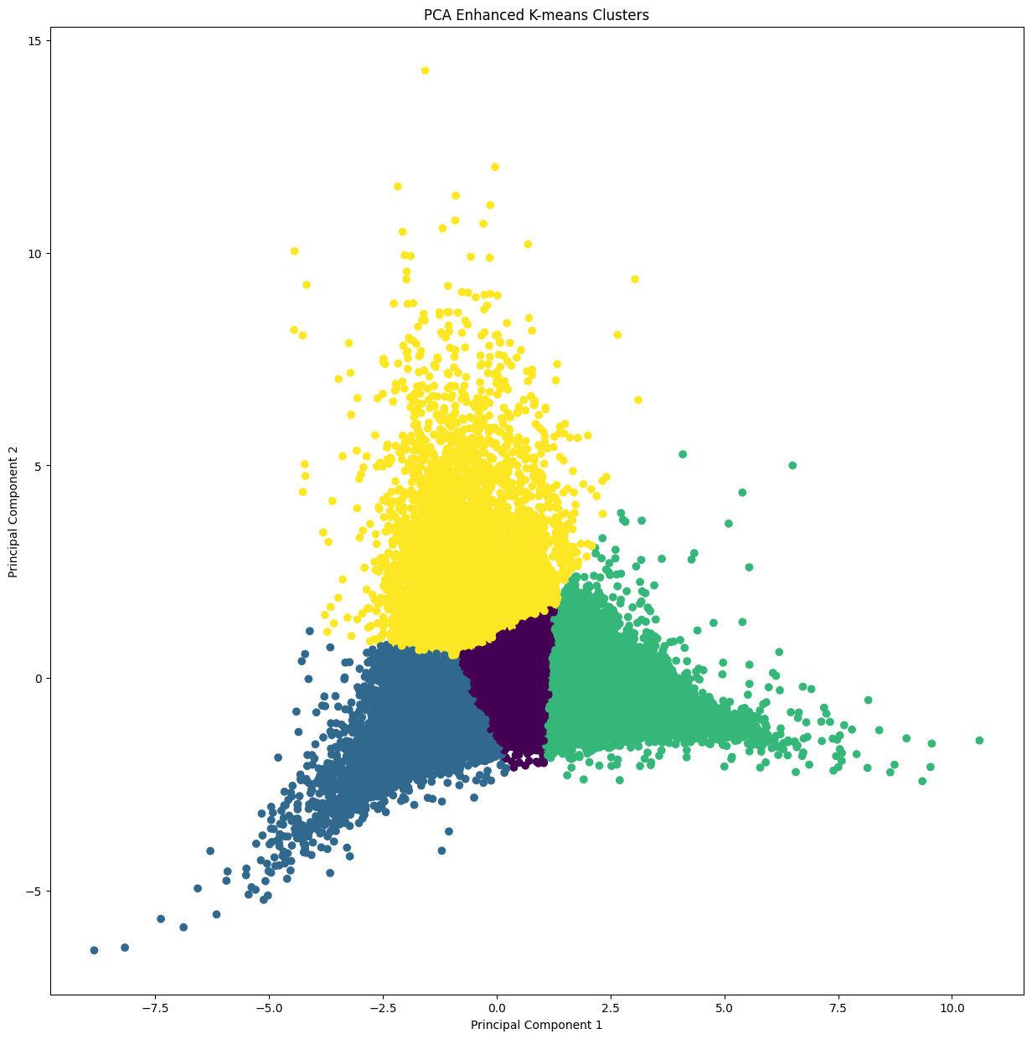
ACE Mission
K-means
K-means with PCA
Notes:
Feature importance was inconclusive with K-means when using the ACE features as given. Clusters did not have a distinct decision boundary and were tightly packed. When prepping the dataset with PCA to create two principal components, K-means was able to create distinct clusters, though they were still right next to each other. DBSCAN clustered 99% of all data points in one cluster resulting in no distinct classification pattern for solar wind types.

Slide 5
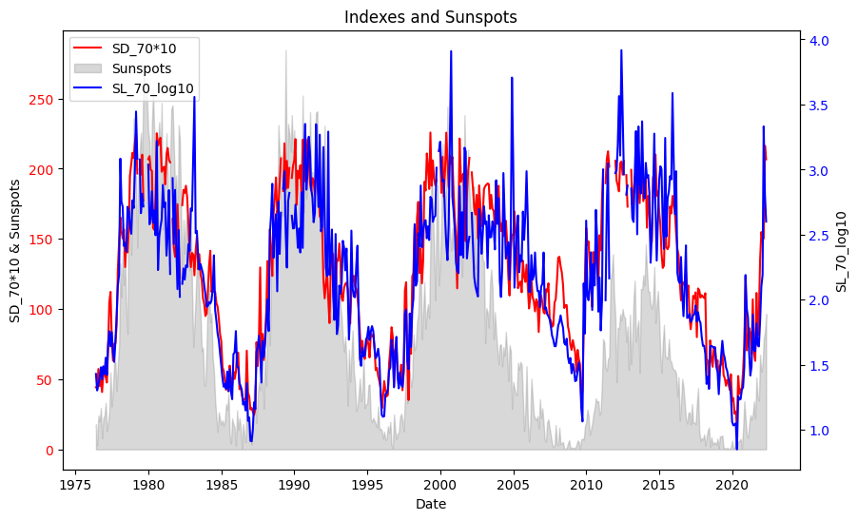
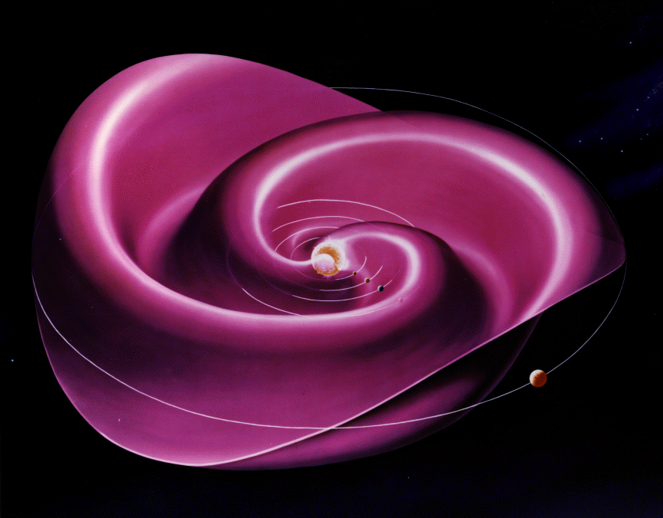
HCS Sunspots
(MAG experiment, A. Balogh and E. Smith)
Notes:
The second part focuses on the heliospheric current sheet indexes. The heliospheric current sheet, or HCS, a plane at the sun’s equator that serves as the boundary between the Sun’s magnetic dipoles. As the sun’s solar cycle progresses, the HCS fluctuates in how wavy and tilted it is. The indexes, which measure both the standard deviation of the HCS’s latitude (SD) and the HCS’s integrated slope (SL), can help measure the HCS’s complexity and track the solar cycle.

Slide 6
HCS Forecast
Outcome Variables:
SD_70: Integral of wave slope at 70° latitude, quantifies HCS deviation from the equator.
SL_70_log10: Measures tilt of current plane at 70°, indicates HCS waviness.
Features Used: Date, Monthly Sunspots, Lag Columns
Model: Ridge Regression
Performance (R²):
SD_70: 0.78
SL_70_log10: 0.59
Notes:
We compared different cross-validated models using R^2 and multiple error metrics and determined Ridge Regression was the best model for forecasting the HCS indexes. The model for SD returned an R2 for 0.78 while the model of SL returned a R2 of 0.59.

Slide 7
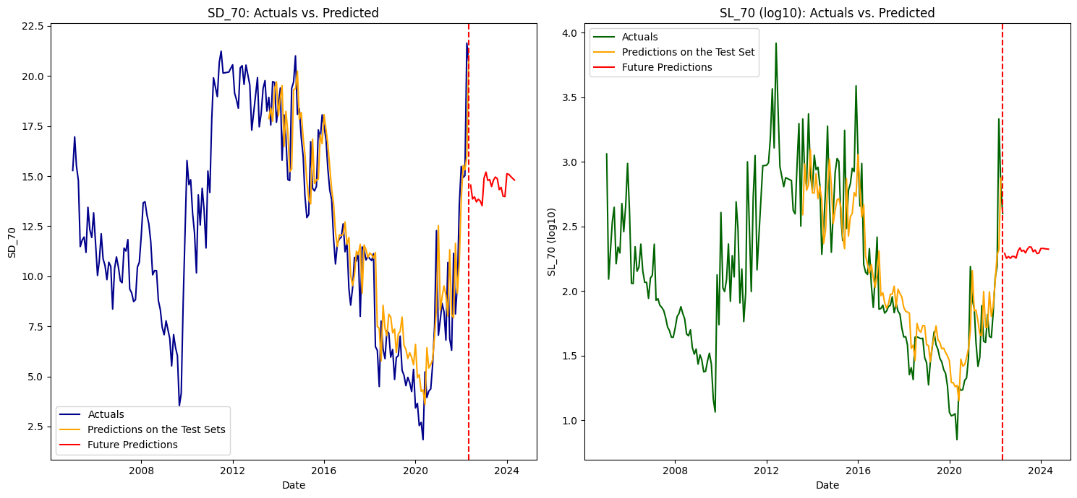
HCS Forecast Results
Notes:
Here you can see side-by-side line charts displaying actual data, predictions on the test set, and forecasts for the next 24 months post-May 2022. The model seems to do well on the data used in the test set, however future data should be used to further evaluate the model’s accuracy
Left chart: SD_70 series. Right chart: SL_70_log10 series.

Slide 8
Conclusions & Recommendations
Collect more HCS index data to refine models.
Incorporate additional features like solar wind data to boost forecasting accuracy.
Notes:
We hope this work lays the groundwork for more precise predictive models in future studies. Our hope is that more HCS index data can be collected to refine the models further and that additional features such as solar wind be incorporated into the models.

Slide 9
Thanks!
Notes:
A huge thank you to Dr. Zhao from the University of Michigan - Ann Arbor Department of Climate and Space Sciences and Engineering and Kyle Balog from the Capstone Course staff. This project was completed under their stellar advice and they were a great help.

